Slide 1

FCAPP - Future Programming Paradigms:
Ad Hoc File Systems
Prof. Raffaele Montella
http://raffaelemontella.it raffaele.montella@uniparthenope.it

Slide 2
Introduction
Storage backends of parallel compute clusters are still based mostly on magnetic disks.
Newer and faster storage technologies such as flash-based SSDs or non-volatile random access memory (NVRAM) are deployed within compute nodes.
Including these new storage technologies into scientific workflows is unfortunately today a mostly manual task, and most scientists therefore do not take advantage of the faster storage media.
One approach to systematically include node-local SSDs or NVRAMs into scientific workflows is to deploy ad hoc file systems over a set of compute nodes, which serve as temporary storage systems for single applications or longer-running campaigns.

Slide 3
FUSE: File System in User Space
Filesystem in Userspace (FUSE) is a software interface for Unix and Unix-like computer operating systems that lets non-privileged users create their own file systems without editing kernel code.
This is achieved by running file system code in user space while the FUSE module provides only a bridge to the actual kernel interfaces.
FUSE is available for Linux, FreeBSD, OpenBSD, NetBSD (as puffs), OpenSolaris, Minix 3, macOS, and Windows.
FUSE is free software originally released under the terms of the GNU General Public License and the GNU Lesser General Public License.

Slide 4
FUSE: File System in User Space
The FUSE system was originally part of AVFS (A Virtual Filesystem), a filesystem implementation heavily influenced by the translator concept of the GNU Hurd.
It superseded Linux Userland Filesystem, and provided a translational interface using lufis in libfuse1.
FUSE was merged into the mainstream Linux kernel tree in kernel version 2.6.14.
As the kernel-userspace protocol of FUSE is versioned and public, a programmer can choose to use a different piece of code in place of libfuse and still communicate with the kernel's FUSE facilities.
libfuse and its many ports provide a portable high-level interface that may be implemented on a system without a "FUSE" facility.

Slide 5
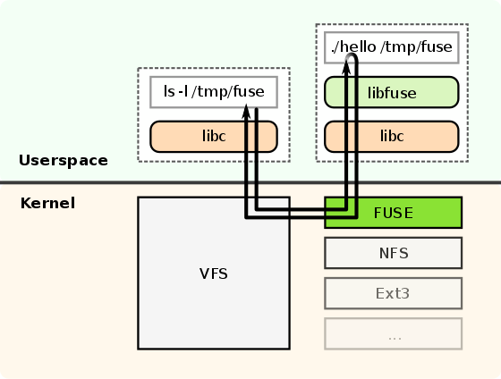
FUSE: How it works
To implement a new file system, a handler program linked to the supplied libfuse library needs to be written.
The main purpose of this program is to specify how the file system is to respond to read/write/stat requests.

Slide 6
FUSE: How it works
he program is also used to mount the new file system.
At the time the file system is mounted, the handler is registered with the kernel.
If a user now issues read/write/stat requests for this newly mounted file system, the kernel forwards these IO-requests to the handler and then sends the handler's response back to the user.

Slide 7
FUSE: How it works
FUSE is particularly useful for writing virtual file systems.
Unlike traditional file systems that essentially work with data on mass storage, virtual filesystems don't actually store data themselves.
They act as a view or translation of an existing file system or storage device.
In principle, any resource available to a FUSE implementation can be exported as a file system.

Slide 8
FUSE: Applications - On-disk file systems
Conventional on-disk file systems can be implemented in user space with FUSE, e.g. for compatibility or licensing reasons.
Linear Tape File System: Allows files stored on magnetic tape to be accessed in a similar fashion to those on disk or removable flash drives.
NTFS-3G and Captive NTFS, allowing access to NTFS filesystems.
Retro-fuse: retro-fuse is a user-space filesystem that provides a way to mount filesystems created by ancient Unix systems on modern OSes.

Slide 9
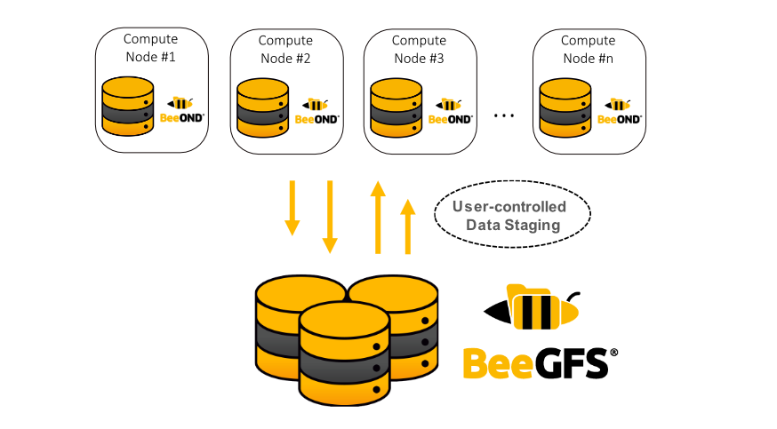
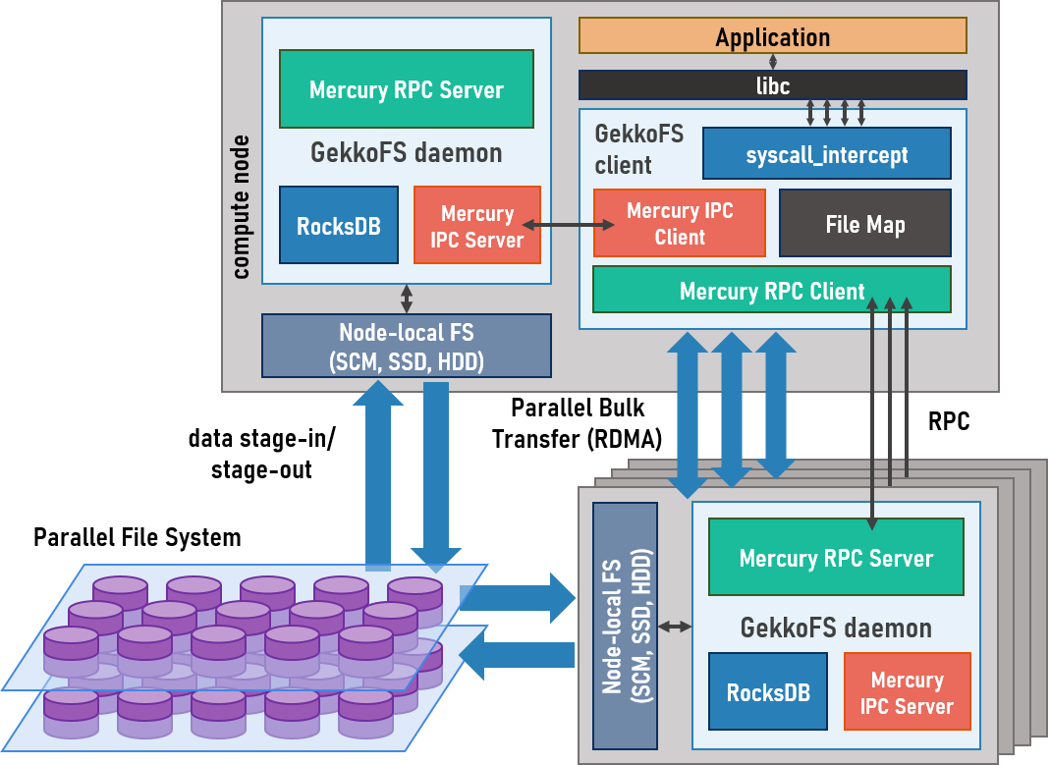
FUSE: Applications
Remote/distributed file system clients
Ad-hoc File System for HPC
BeeOND (https://doc.beegfs.io/latest/advanced_topics/beeond.html)
GekkoFS (https://storage.bsc.es/projects/gekkofs/documentation/)
BurstFS (https://github.com/LLNL/burstfs).
Brinkmann, André, Kathryn Mohror, Weikuan Yu, Philip Carns, Toni Cortes, Scott A. Klasky, Alberto Miranda, Franz-Josef Pfreundt, Robert B. Ross, and Marc-André Vef. "Ad hoc file systems for high-performance computing." Journal of Computer Science and Technology 35 (2020): 4-26.

Slide 10
FUSE: Applications - Archive and backup file systems
FUSE filesystems can expose the contents of archives or backup sets without having to first extract them.
archivemount
Atlas (Rubrik backup software): Immutable, distributed filesystem used by Rubrik Cloud Data Management data protection applications
Borg (backup software): Deduplicating backup program that allows backup archives to be mounted as FUSE filesystems.
Restic: Free, fast, efficient and secure backup software uses FUSE to be able to browse all of your backup snapshots as a regular file system
SPFS A file system for Spectrum Protect, designed to mount the backup server filespace anywhere on your server, and use the features included from the backup server (encryption, de-duplication, compression, filtering etc). This is a WORM file system.

Slide 11
DAGonFS
DAGonStar: yet another workflow engine: https://docs.google.com/presentation/d/1e0hXXY94m3ZJ6efQdpMJGx47X8ZCcrsg_KbiZudWt84/edit?usp=sharing
An ad-hoc file system for workflow engines

Slide 12
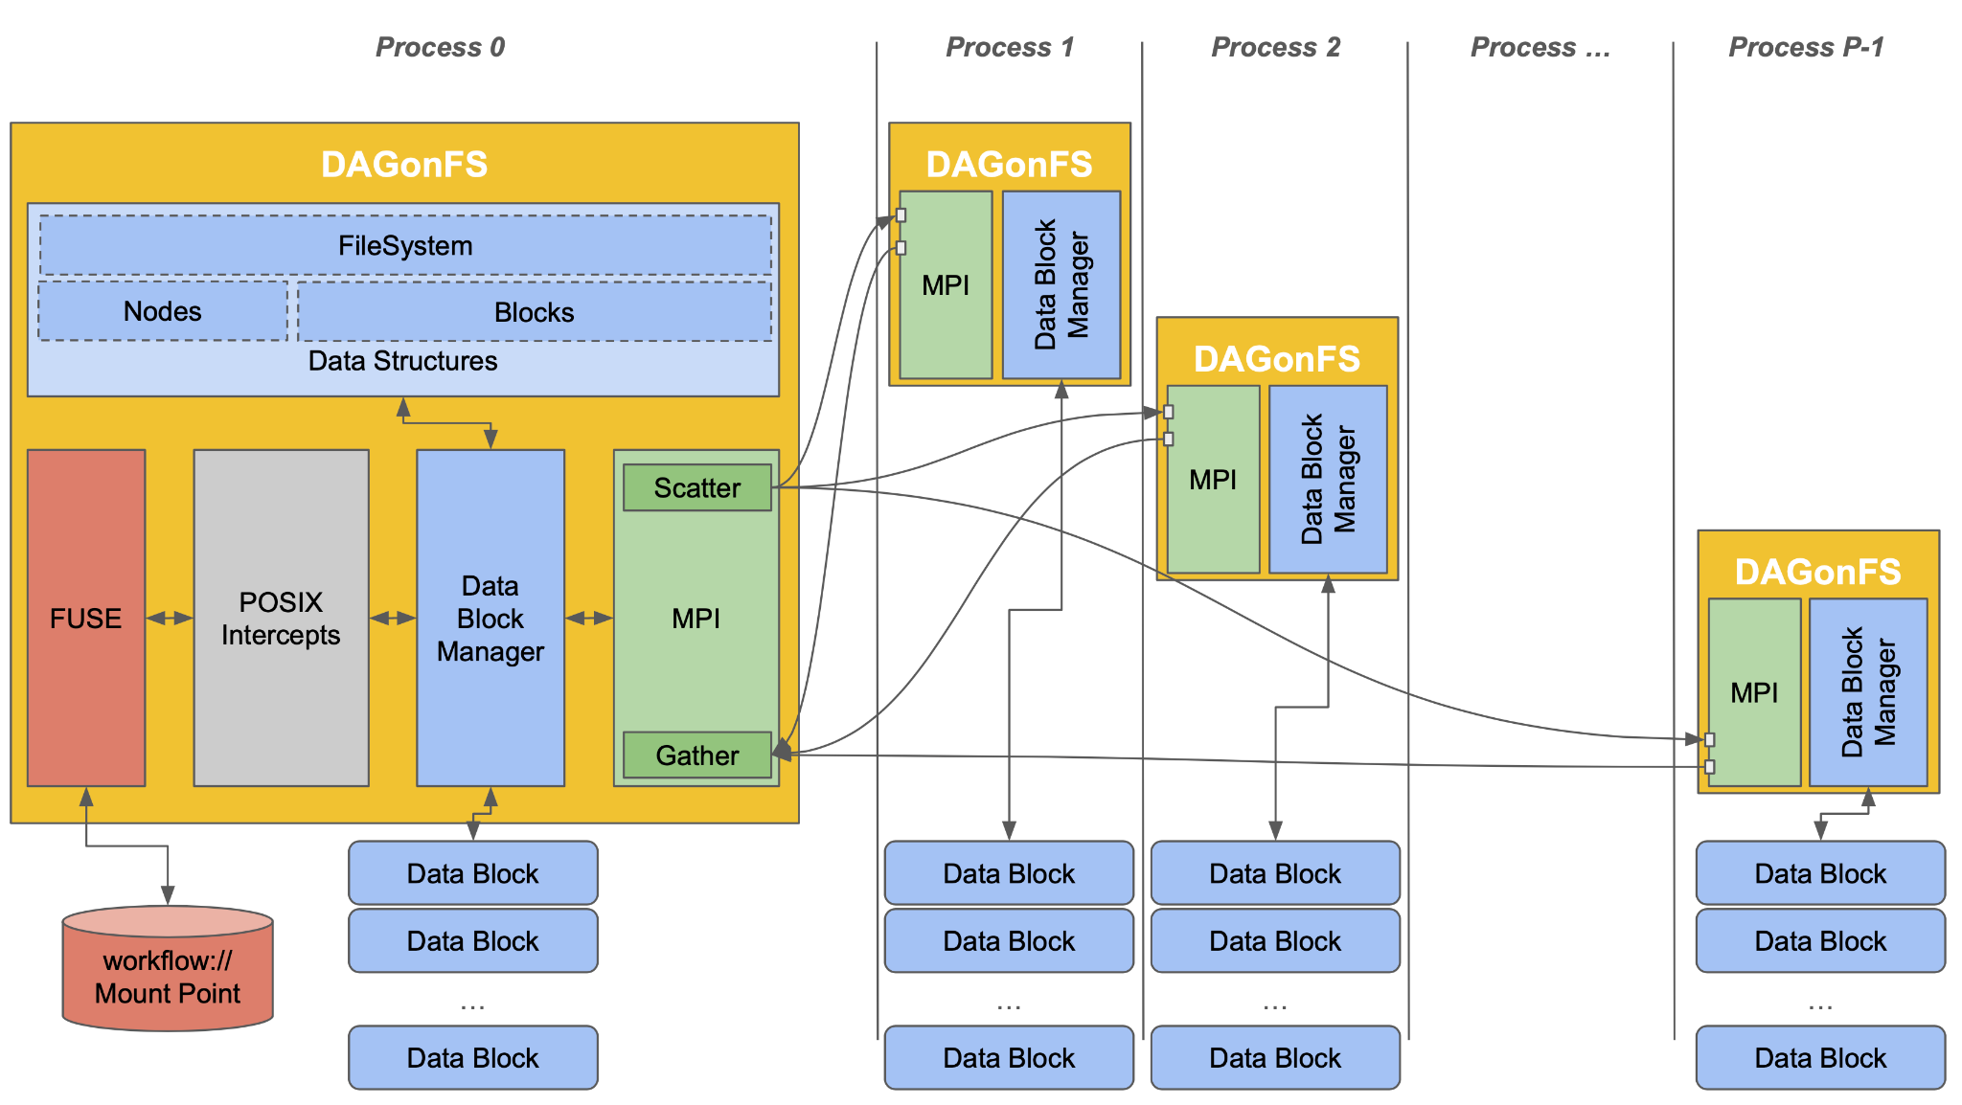
Architecture

Slide 13
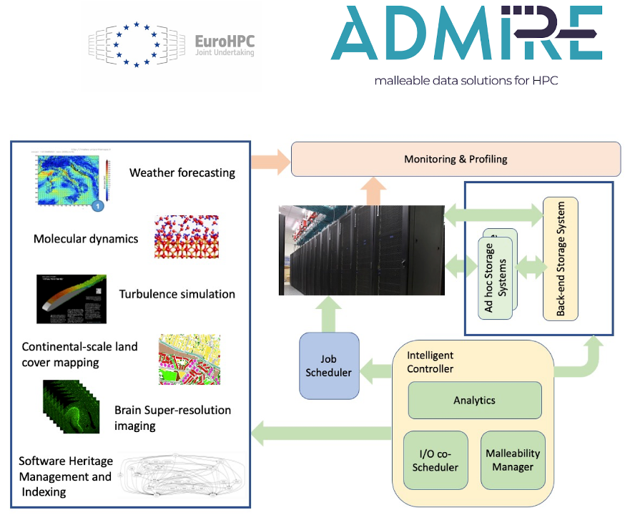
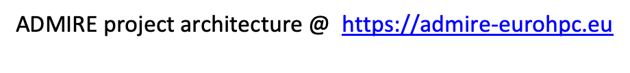
Motivation (I)
€ 7.9 million overall budget (2021-2024)
19 partners in 6 EU countries
Key points:
→ Adaptive multi-tier data management
→ Computational and I/O malleability
→ Continuous monitoring
→ Focus on ad-hoc storage systems
→ Transparent data staging
→ Use cases from industry and academics

Slide 14
Motivation (I)
I/O-intensive HPC-based applications have been primarily based on distributed object-based file systems.
→ Separate data from metadata management.
→ Enable each client to communicate in parallel with multiple storage servers.
Exascale I/O raises the throughput and storage capacity requirements by several orders of magnitude.
Current challenges:
→ Systems already developed for data analytics are not directly applicable to HPC due to the fine-granularity involved in scientific applications.
→ Semantic gap between the application requests and the way they are managed by the storage back-end at the block level.

Slide 15
Motivation (II)
Alluxio conforms a storage solution located between computation frameworks and persistent data stores that aims to reduce the complexity of storage APIs while taking advantage of memory speed
Hermes focuses on the implementation of a MRAM based storage system improving file system performance through the effective use of MRAM devices.
WekaIO provides a high-performance storage architecture
However, they lack of:
→ Data locality mechanisms.
→ Ad-hoc storage characteristics.

Slide 16

Motivation (III)
Malleability can adapt the storage system to the application I/O needs during the different phases of execution.
To extend or to shrink the ad-hoc files system deployment on runtime, following application I/O demands.
To accelerate the I/O intensive phases.
To reduce memory footprint of in-memory storage backend.

Slide 17
ADMIRE: Enable system actions based on data
Observation → Action
1.ADMIRE Goals – Create an active I/O stack that dynamically adjusts computation and storage requirements.
2.ADMIRE Means – Software-defined framework with intelligent global coordination, malleability of computation and I/O, and the scheduling of storage resources along all levels of the storage hierarchy.
3.ADMIRE Principles – Scalable monitoring and control, separated control and data paths, and the orchestration of key system components and applications through embedded control points.

Slide 18
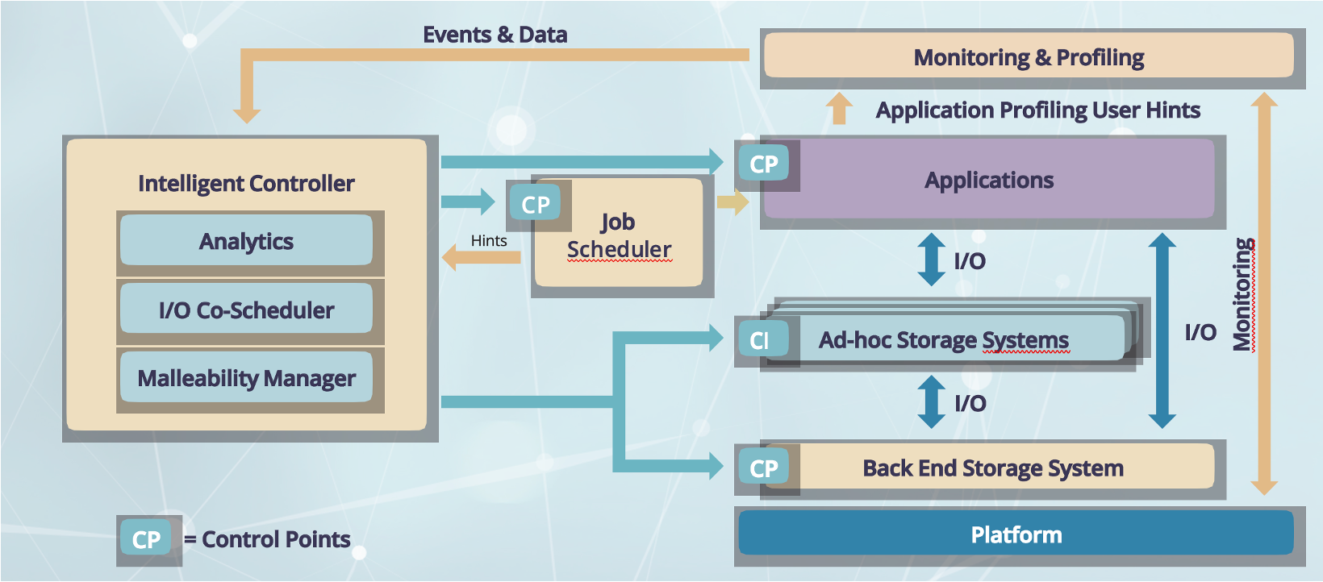
The framework

Slide 19
Adaptive I/O. Ad-hoc storage systems
Deployed for an application or workflow
→ Implement temporary ad hoc storage systems with resilience features
→ Support fast node-local storage technologies (e.g., RAM, NVMe, SSD, ..)
Four types of ad hoc storage systems
→ Distributed file system based on the GekkoFS burst buffer file system
→ Distributed object-oriented data store based on dataClay
→ Hercules In-Memory Storage System and
→ Expand, ad-hoc DFS based on MPI with external connectors.
All ad-hoc storage systems support the same APIs
→ POSIX -> LD_PRELOAD
→ Custom I/O interfaces possible, but may require application changes
General data staging approach in ADMIRE via I/O scheduler
→ Allows backend PFS independence

Slide 20
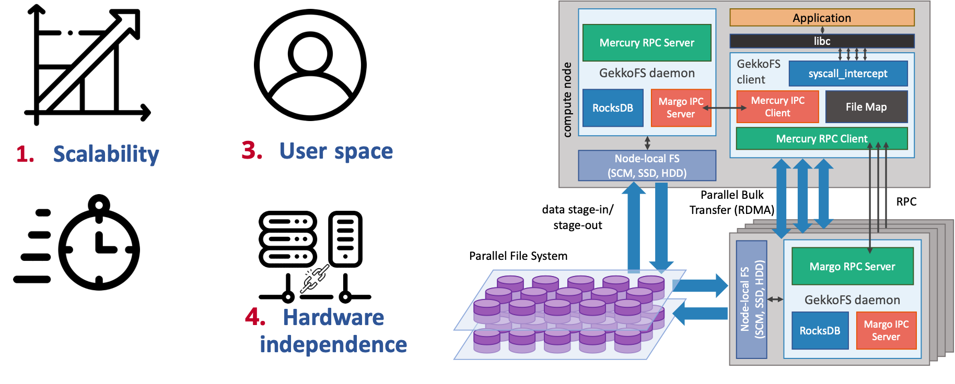
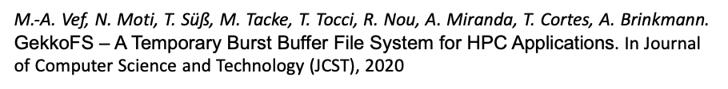

Architecture

Slide 21
Challenges of LD_PRELOAD-based FS libraries
Intercepts any function
Supporting all libc I/O functions is a daunting task
Other I/O interfaces, e.g., MPI I/O need special treatment
Syscall_intercept helps to an extend
No valid mount point requires path checking
Detangle relative paths
Separate file descriptor management necessary
Threads and forks don’t mix
I/O library has no control over application or 3rd party library threads
fork() can lead to dead-locks
Minimal interception library required
Malleability techniques limited
Any technique is confined to one process that can stop at any time
Node-wide client solution necessary

Slide 22
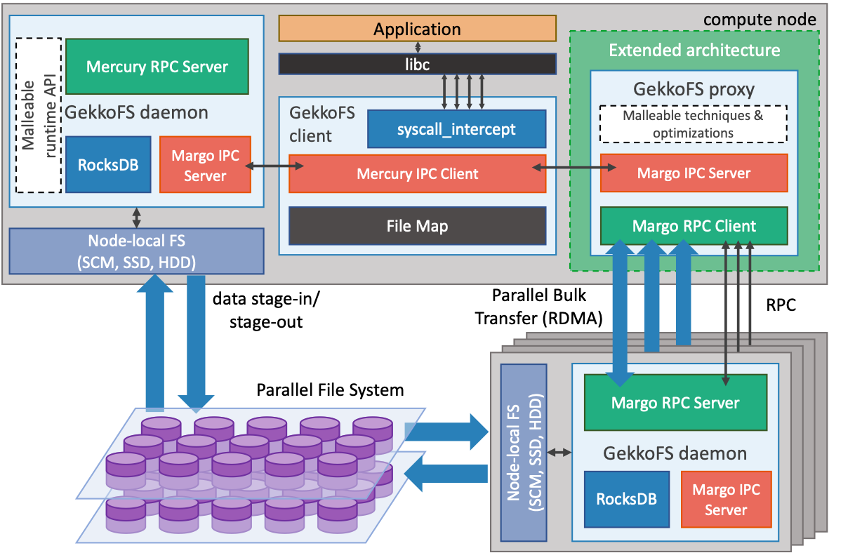
GekkoFS Redesign

Slide 23
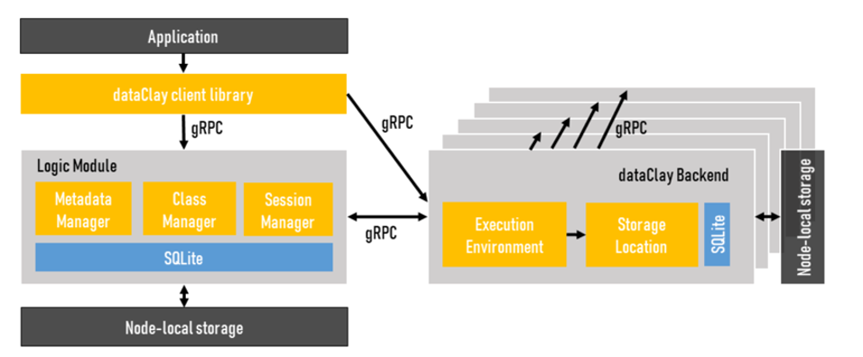
dataClay
•An active object store for HPC, Big Data, and Edge-to-Cloud applications
•Runs on heterogeneous infrastructures
•Brings computation to the data, enabling execution of custom user code
→ Objects = data + methods
→ Reduces communication costs and improves application performance
•Manages objects in-memory during execution
→ Avoids transformations and reduces disk accesses
•APIs
→ Object-oriented: transparent persistence (Python and Java bindings)
→ Object store: Get/Put operations

Slide 24
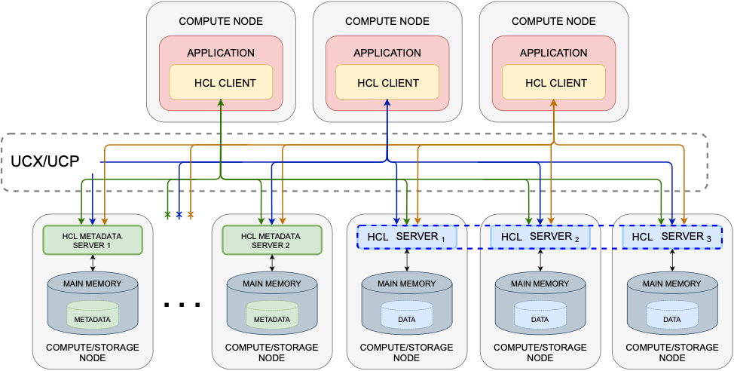
Hercules
•In-memory IO accelerator for volatile data.
•POSIX-based support for portability.
•Use cases:
→ HPC workflows.
→ Checkpointing engines.
→ Distributed locking
•Main features
→ Supports attached/detached storage servers
→ Supports several data distribution policies
→ Efficient storage backend based on GLIB.
→ Write on close policy.
→ Integrated with SLURM.
→ Data replication

Slide 25
Portable communication layout
Based on UCX
→ Unified Communication - X Framework (UCX) is a new acceleration library, integrated into the OpenMPI, OpenSHMEM, Dask, …
Key aspects
→ Multiple network interfaces/protocols available (TCP/IP, Omnipath, Infiniband supported).
→ Zero-copy message transfers of large data packages (>= 1 Mbytes).
→ Eliminated internal copies from application to network layer.
→ Asynchronous communication between peers.
→ RDMA QoS isolation.
→End-point/two-sided-based communication.

Slide 26
UCX communication layer developed
Non-blocking/tag-based communication (MPI style)
→ Asynchronous communication between peers.
Low-level communication schema (in contrast to Margo RPC)
Frontend
→ Data and metadata UCX’s workers enables communication overlap.
→ QoS
- Interfaces and protocols can be enabled/disabled to adapt network requirements.
- Communication can be upgraded/downgraded (Infiniband/Omnipath to TCP).
→ Communication parameters configured by using environment variables.
Backend
→ One single listener per worker thread.
→ Stores a pool of active end-points (two-sided communication).

Slide 27
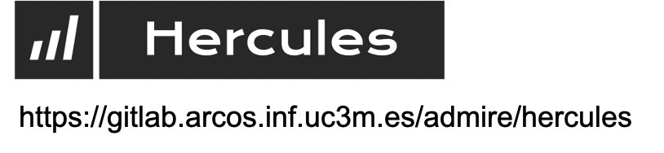
Hercules
Ad-hoc/in-memory storage solution for volatile data.
Distributed key-value store.
Provides a flexible API.
Makes use of main memory as the storage device.
Provides multiple data distribution policies.
Exposes a POSIX/non-POSIX interface.
Open source project.

Slide 28
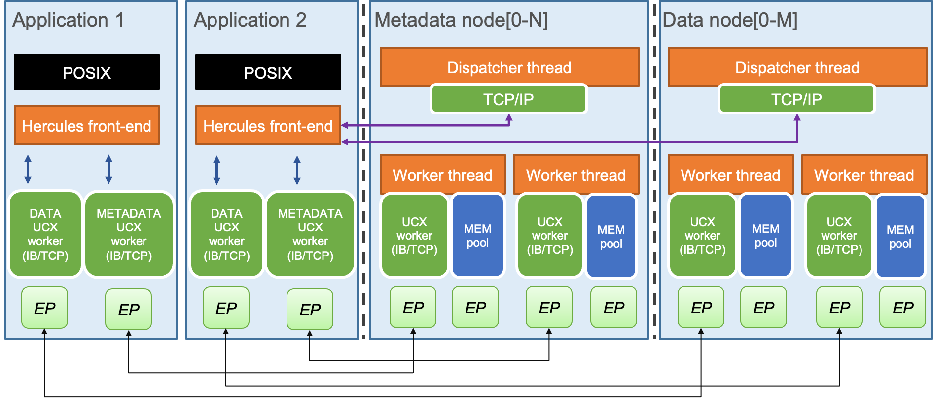
Hercules

Slide 29
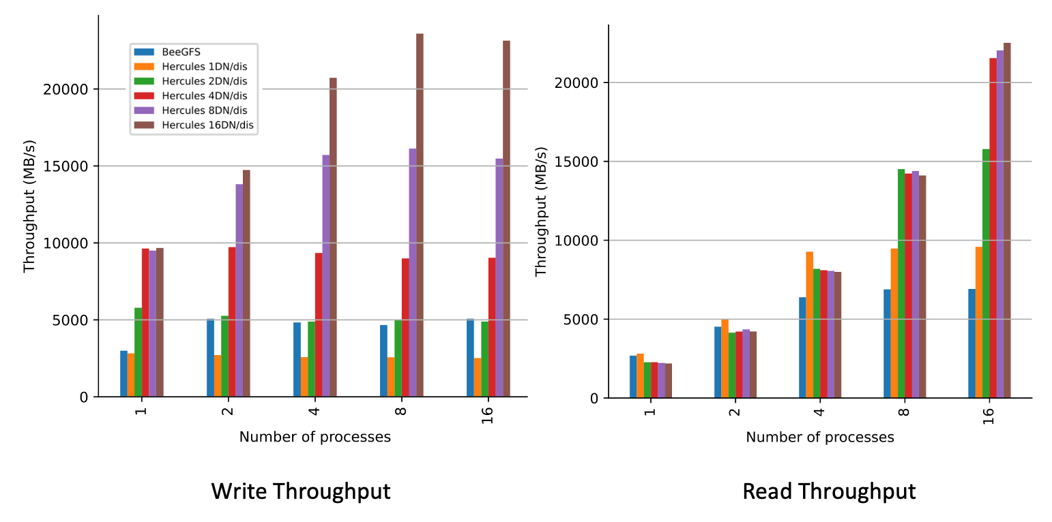
Evaluation

Slide 30
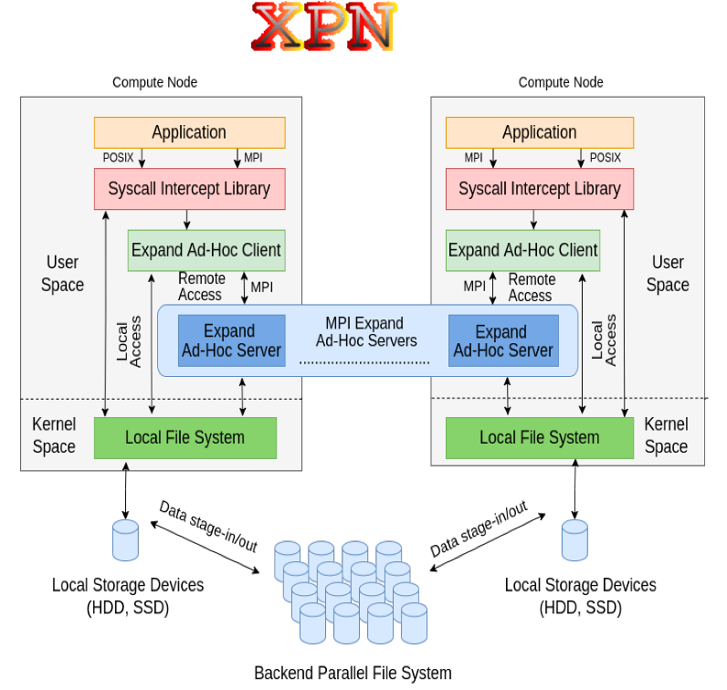

Expand Parallel File System
Expand ad-hoc file system
•Parallel, distributed file system based on the use of existing standard storage servers.
•MPI-based
•Distribution based on subfile/server and Round Robin
•Fully distributed metadata (B0 of each file) by hash
•Aggressive parallel I/O ops
•Client-servers may be co-located

Slide 31
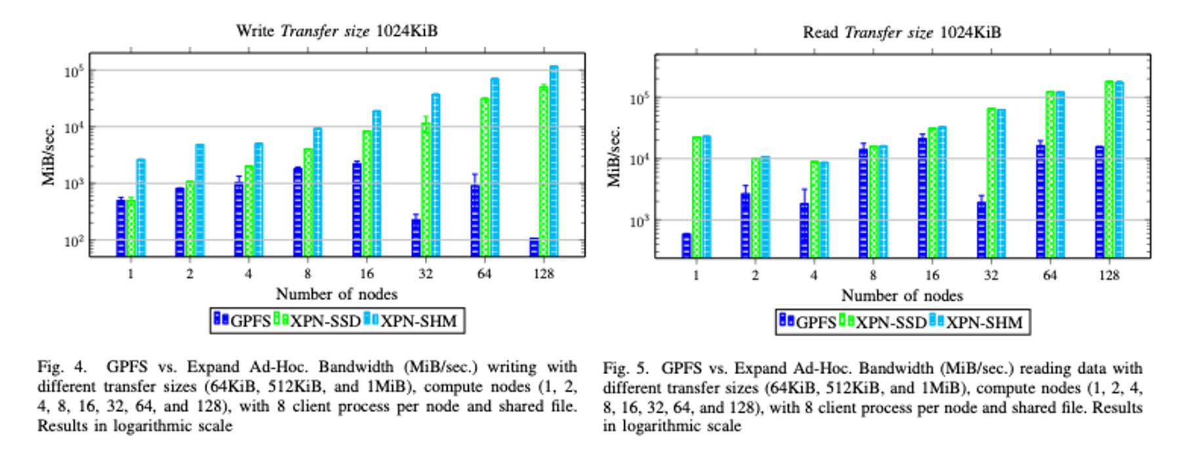
Performance of Ad-hoc Expand
IOR in MareNostrum

Slide 32
Current efforts
Malleability
➢Expanding/shrinking the number of data nodes.
Monitoring
➢Integration with existing monitoring tools.
Replication / Mirroring
Error correction schemes
➢ECC/parity.
➢To implement distributed parity calculations on advanced data placement schemes.

Slide 33
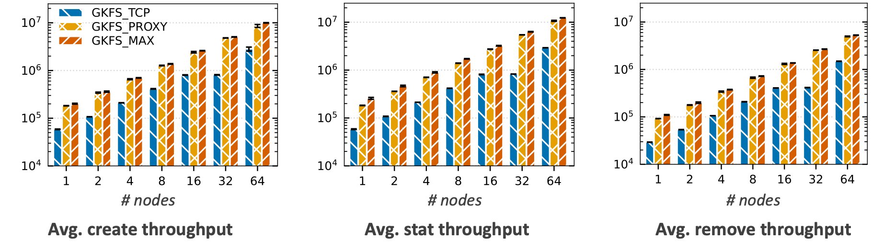
Evaluation
100K zero-byte files per process (16 processes per node)

Slide 34
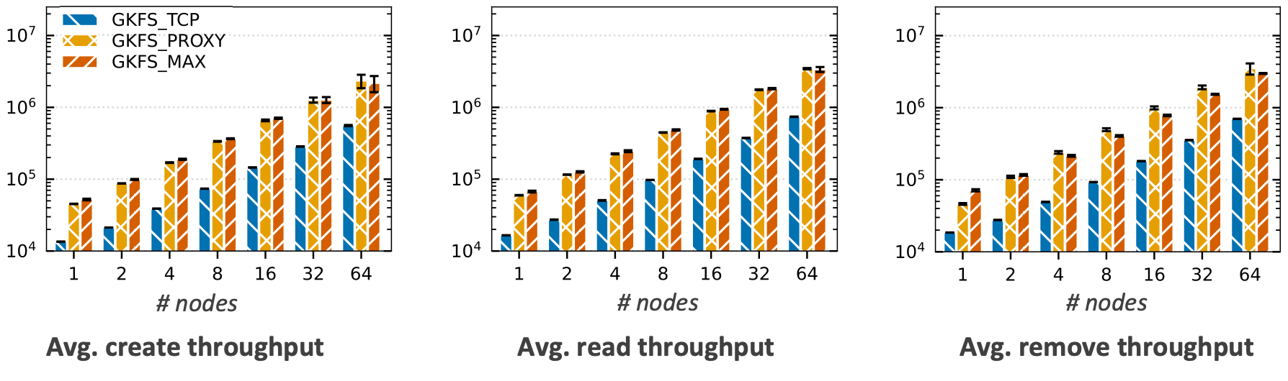
Evaluation
100K 4 KiB files per process (16 processes per node)

Slide 35
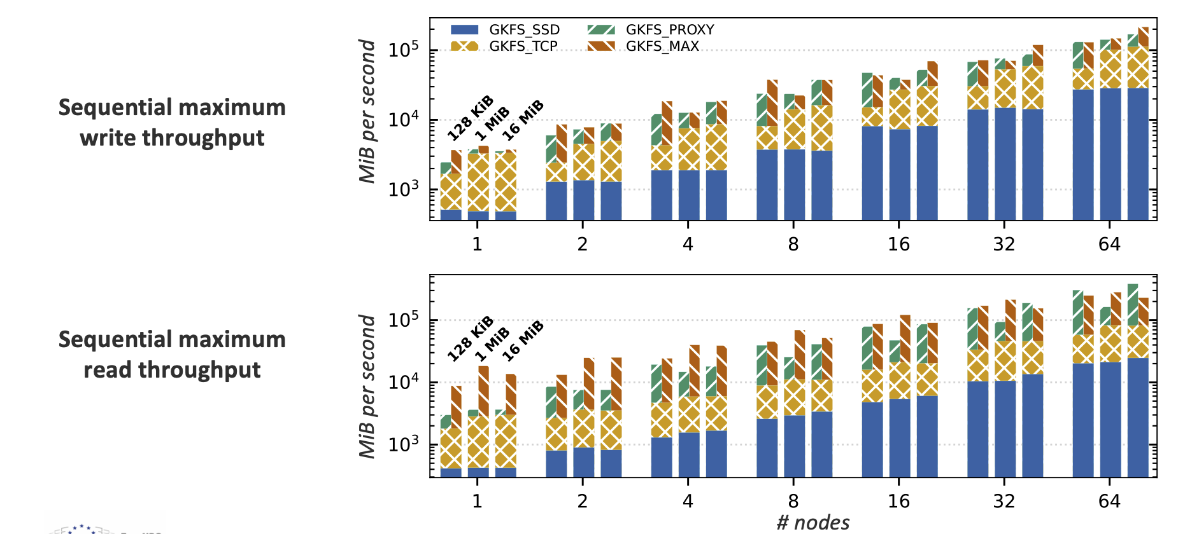
Evaluation
Data throughput

Slide 36
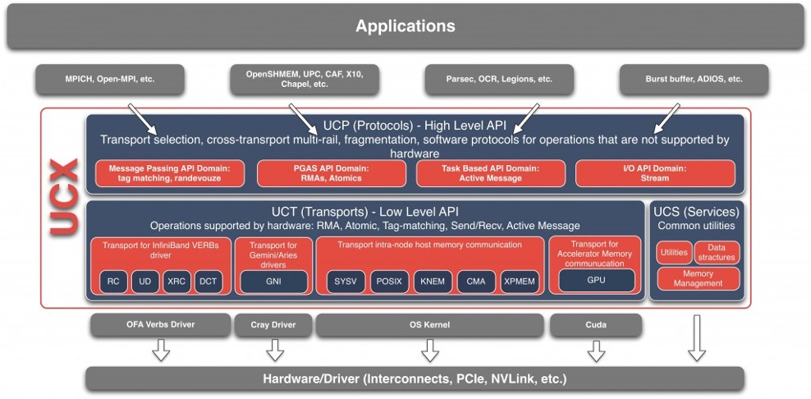
Unified Communication X (UCX)
Generic abstraction of the network layer
Supported devices: Infiniband, Omni-path, TCP, shared memory
Zero-copy
MPICH, OpenMPI, Dash , Spark, Charm++, …

Slide 37
Features
Migrated from ZeroMQ to UCX.
Benefits of using UCX inside Hercules:
→ Multiple network interfaces/protocols available (TCP/IP, Omnipath, Infiniband supported).
→ Zero-copy message transfers of large data packages (>= 1 Mbytes).
→ Eliminated internal copies from application to network layer.
→ Asynchronous communication between peers.
→ RDMA QoS isolation.
→ End-point/two-sided-based communication.
Fully implemented POSIX support (passed full IO500 benchmark).

Slide 38
New communication layer developed
Non-blocking/tag-based communication (MPI style)
Low-level communication schema (in contrast to Margo RPC)
Client-side
→ Data and metadata UCX’s workers enables communication overlap.
→ Malleability
- Client nodes store a list of current available workers.
- This list can be adapted during runtime.
→ QoS
- Interfaces and protocols can be enabled/disabled to adapt network requirements.
- Communication can be upgraded/downgraded (Infiniband to TCP).
→ Communication parameters configured by using environment variables.
Server-side
→ One single listener per worker thread.
→ Stores a pool of active end-points (two-sided communication).

Slide 39
Interception of I/O system calls
Hercules intercepts library and IO system calls.
Simplifies migration and deployment.
Support for
Multiple programming languages: C/C++, Python, Fortran.
Multi processes (fork and threads).
Complex scripting
Initial version based on four systems calls:
Native POSIX functions: 4 Library calls: 0
Current version supports up to:
Native POSIX functions: 75 Library calls: 12

Slide 40
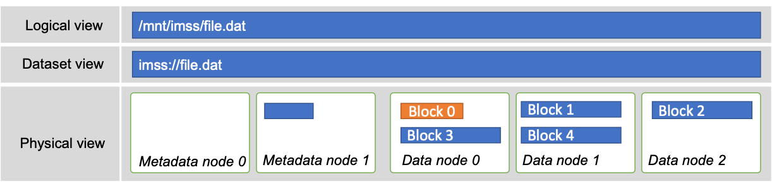
Internal data layout
Data paths are translated from logical to dataset shape (logical view).
Files are divided into multiple blocks under multiple data nodes (physical view).
Distribution policy determines the physical location of blocks, mapping the physical data/metadata nodes (mapping).
Inter-node metadata information is stored at the first metadata node mapping(0).

Slide 41
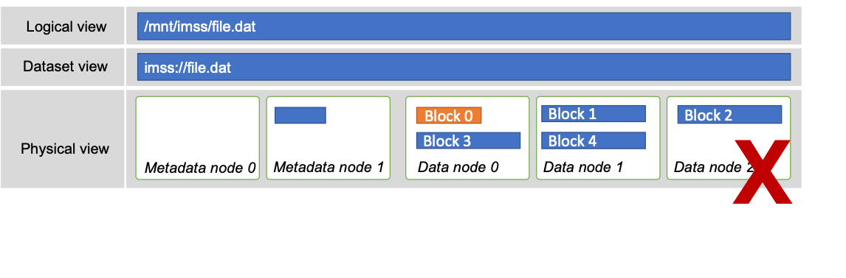
Internal data layout
Malleability seriously affects the block distribution layout.
Solutions:
→ Offline data migration.
→ New mapping bitmap of blockset.

Slide 42
Malleability heuristics
Malleability operations can be started by two alternatives sources:
→ external controller or
→ internal heuristic.
Internal heuristic determines whether a malleability operation should be carried out.
Users define recommended I/O throughput (RIO) for the I/O system.
Hercules tracks the current throughput provided by the I/O system to the application (AIO).
Throughput distance is currently computed using a time series obtained by write/read in-place monitoring:
→ Consecutive operations,
→ Datasets accesses.

Slide 43
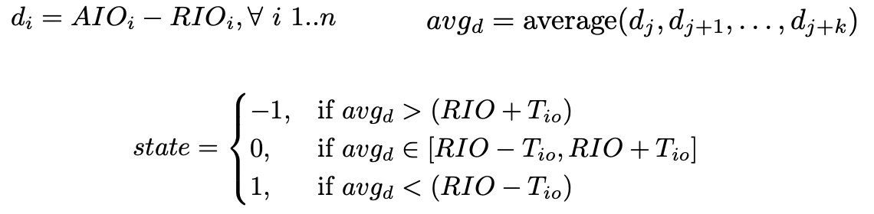
Malleability heuristics
Hercules will take three possible decisions:
→ Keeping the same number of servers,
→ On-line commissioning for expanding the file system servers, or
→ Off-line decommissioning for shrinking the file system servers.
Following the former definitions, Hercules datasets are tagged: commissioning, decommissioning, or ready.

Slide 44
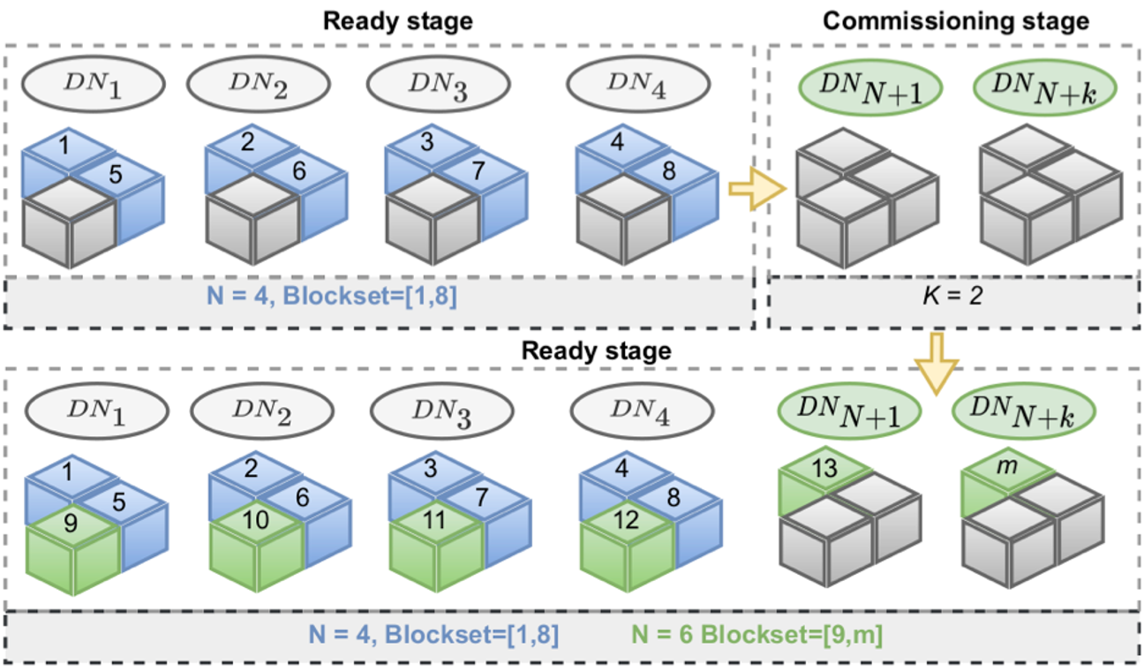
Commissioning

Slide 45
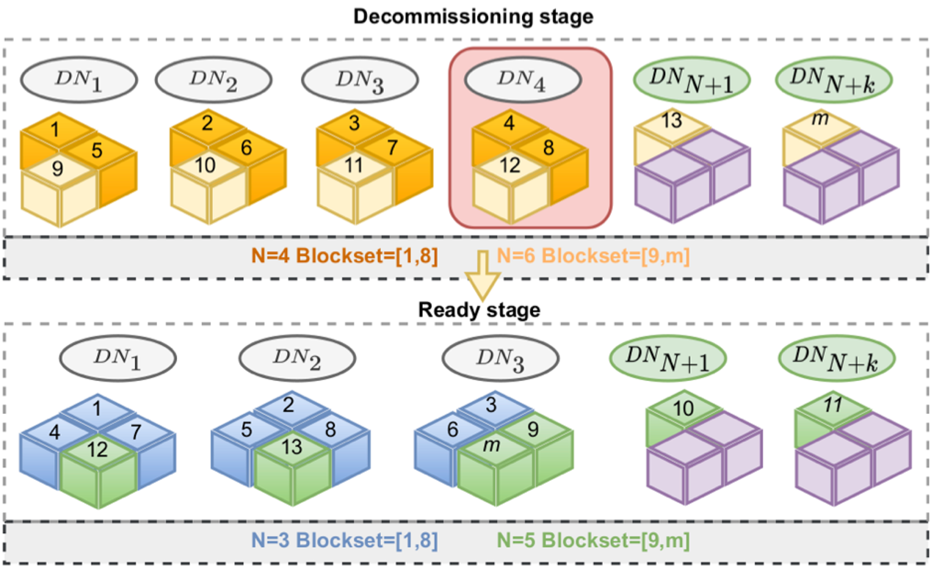
Decommissioning

Slide 46
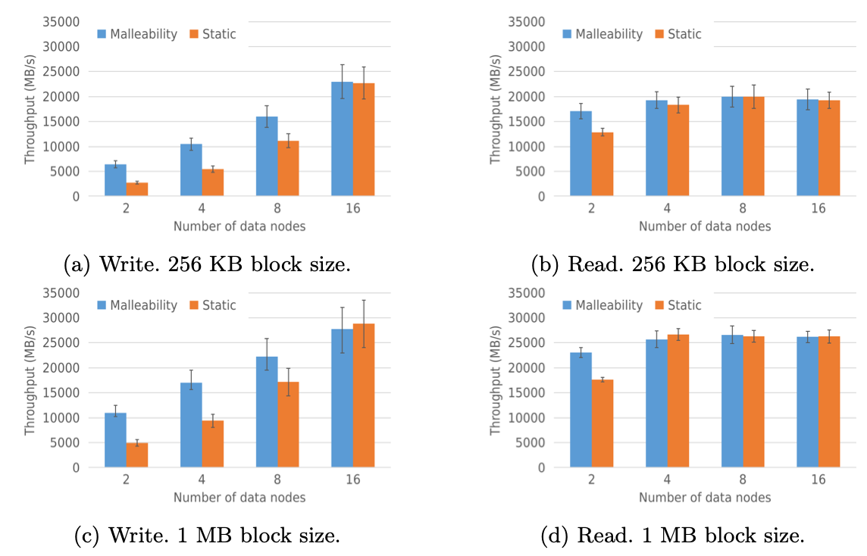
Weak scalability
IOR. Single shared file 100 Mbytes per compute node. 16 computes nodes.

Slide 47
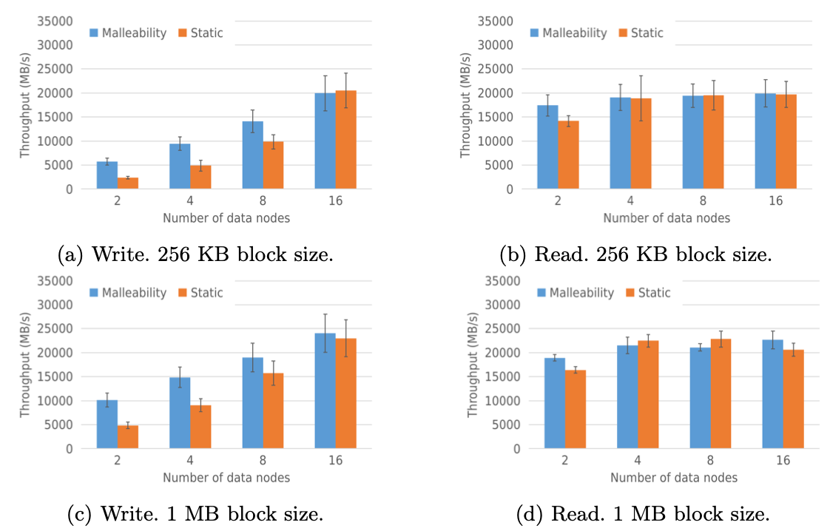
Strong scalability
IOR. Single shared file of 1 Gbytes. 16 computes nodes.

Slide 48
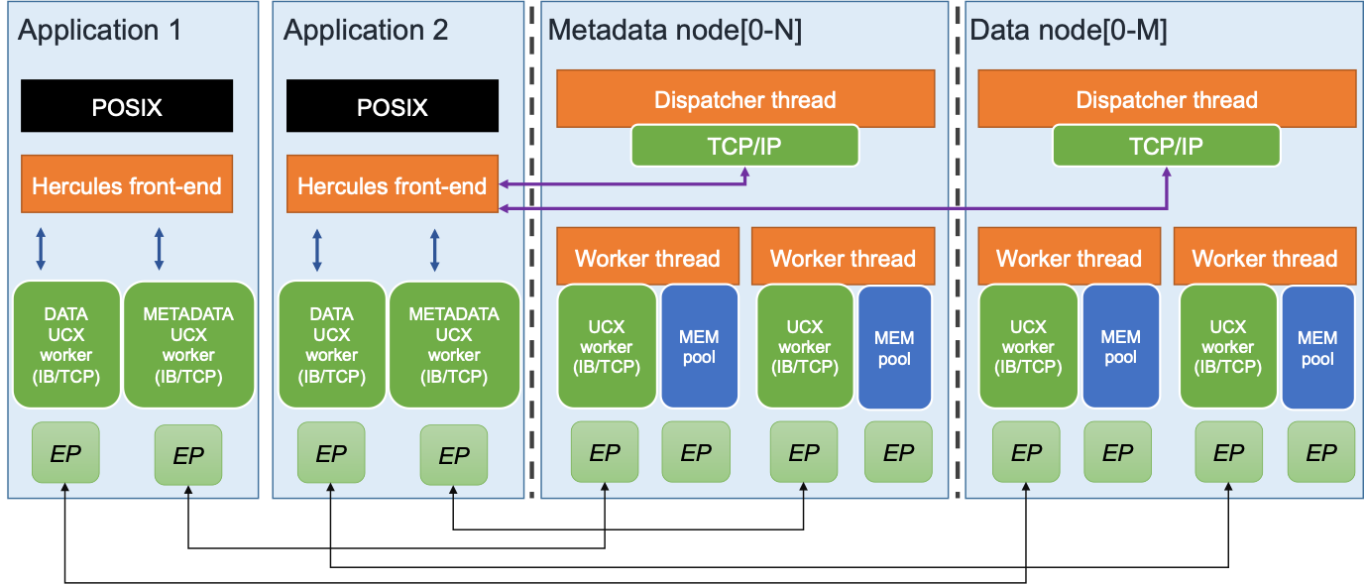
Architecture

Slide 49
Data distribution policies
ROUND ROBIN: data blocks are distributed among the Hercules servers.
BUCKETS: each dataset is divided into the same number of chunks as number of servers. Each chunk is composed by a consecutive number of data blocks, equally distributed. Then, each chunk is assigned to a unique server.
HASHED: a hash operation is applied over each data block key to discover the mapped server.
CRC16bits & CRC64bits: similar to HASHED policy, but a sixteen/sixty four bits CRC operation is applied over the data block key.
LOCAL: each data block is handled by the Hercules server running in the same node that the client.

Slide 50
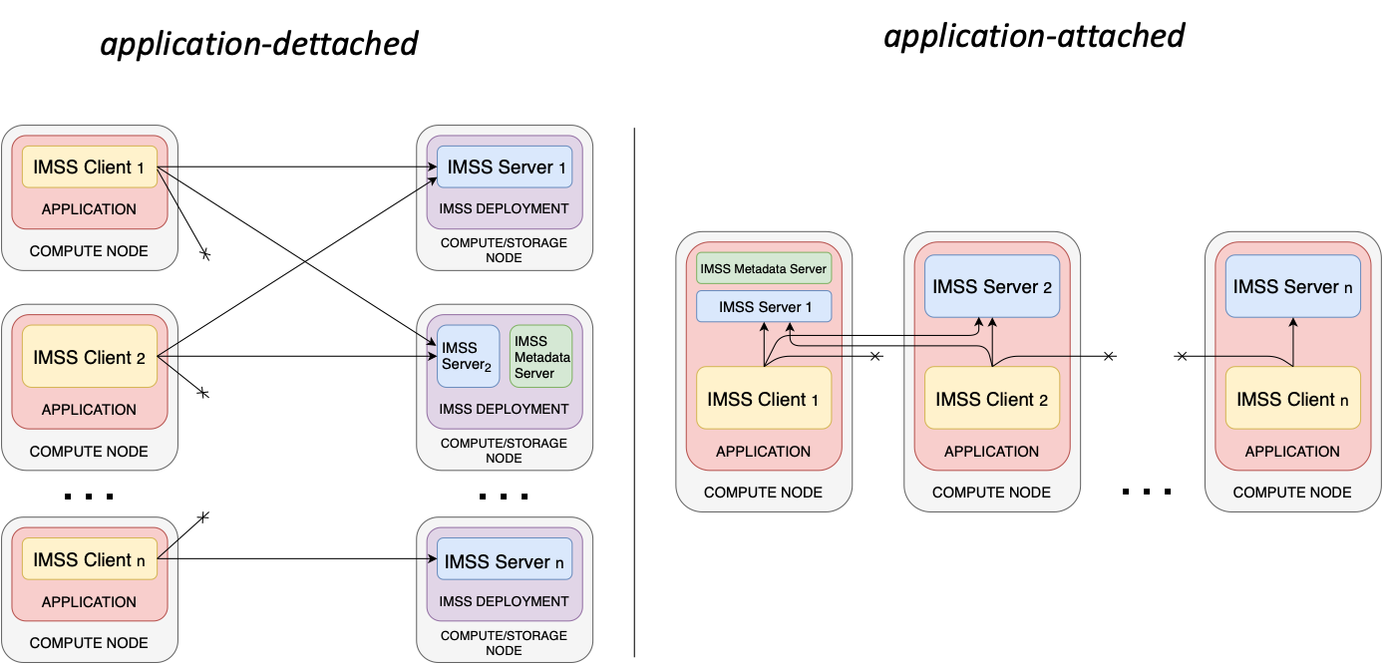
Deployment strategies

Slide 51
Access to the storage infrastructure
API library
FUSE
LD_PRELOAD by overriding symbols
Facilitates to integrated with existing applications.
Works on booth attached and detached deployment strategies.
Passed IO500 benchmark succesfully.

Slide 52
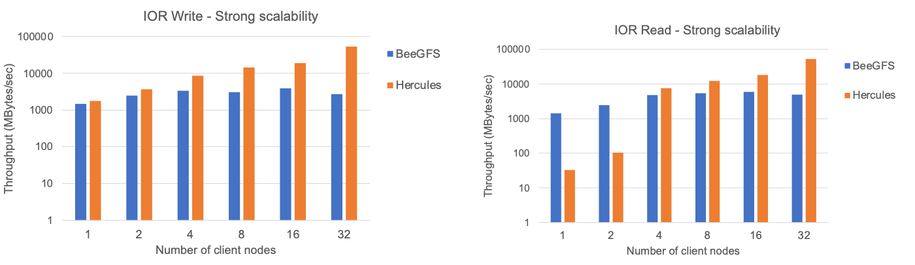
Evaluation
University of Torino cluster
64 Broadwell compute nodes
Intel Onmi-path running at 100 Gbps
UCX 1.15
OpenMPI 4.1

Slide 53
Evaluation (Scalability)
IOR.
Strong scalability, single shared file accesses.
512 Kbytes block size.

Slide 54
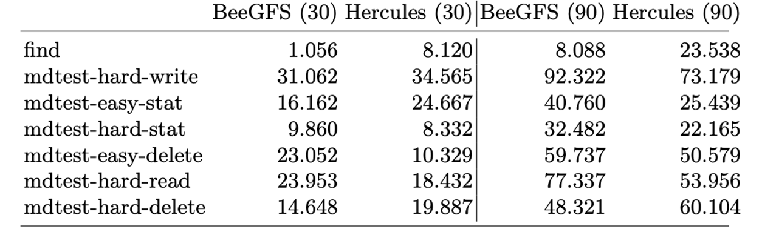
Evaluation (Metadata)
IO500 benchmark.

Slide 55
Hands-on
Multiple ways to deploy Hercules:
User level space
hercules start -s 0 -m /hercules/metadata -d /hercules/data -f /hercules/conf/hercules.conf
Slurm
hercules start –f /hercules/conf/hercules.conf
Docker containers

Slide 56
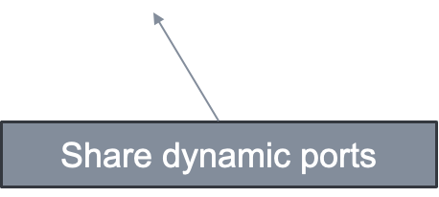
Hands-on (Docker containers)
Download images from DockerHub
docker pull arcosuc3m/hercules_server
docker pull arcosuc3m/hercules_client
Running both data and metadata servers in the same container:
docker run –name hercules_server --network="host" arcosuc3m/hercules_server

Slide 57


Hands-on (Docker containers)
Running some client commands
docker run -it --network="host" arcosuc3m/hercules_client ls -l /mnt/hercules
docker run -it --network="host" arcosuc3m/hercules_client ior -k -w -o /mnt/hercules/test
docker run -it --network="host" arcosuc3m/hercules_client ls -l /mnt/hercules
docker run -it --network="host" arcosuc3m/hercules_client ior -k -r -o /mnt/hercules/test

Slide 58
Future work
Malleability:
→ Current efforts by modifying existing pools for controlling data location.
Monitoring
→ Performance metrics already gathered (i.e., memory bandwidth, network bandwidth).
QoS
→ Degrade performance in presence of application computing peaks.
→ Memory usage.

Slide 59
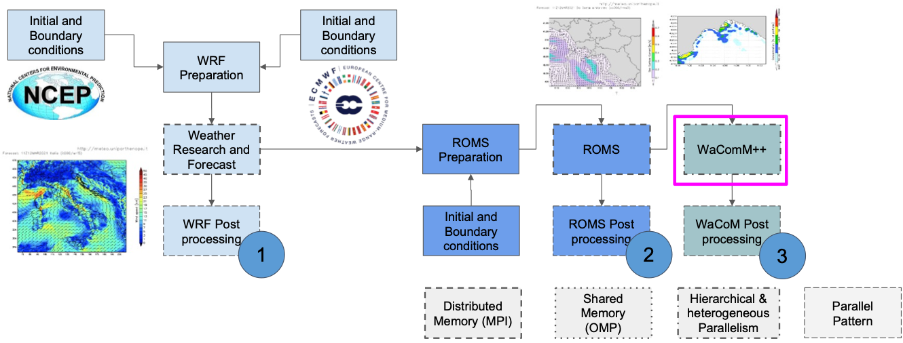
Use case: Environmental Sciences
The applications’ building blocks:
1.Weather Forecast
2.Ocean Dynamics Forecast
3.Inert Transport and Diffusion Forecast

Slide 60
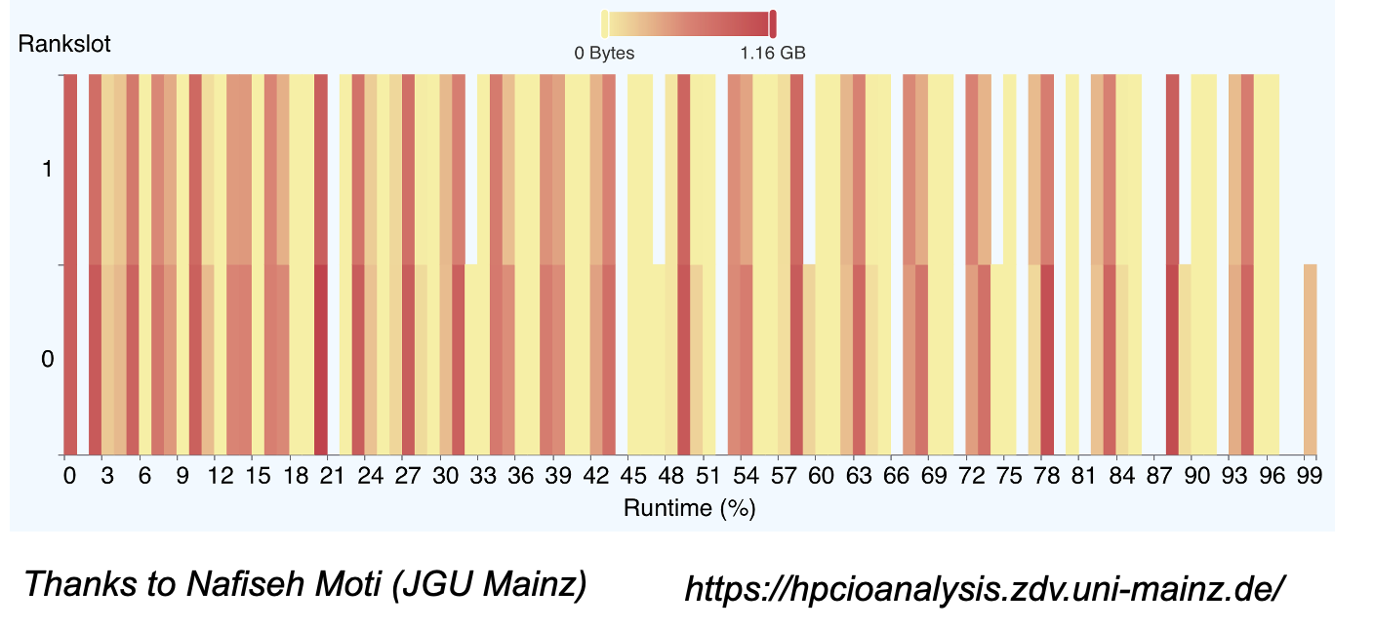
I/O heatmap
HPC IO analysis

Slide 61
Use case: Quantum-Espresso
Car-Parrinello molecular dynamic simulation of large molecules and small proteins – Supported by CINECA
Describe complex electronic interactions (e.g. proteins with metals) to improve drug design and metabolomics processes
Quantum-Espresso is used to run and manage these simulations.
Computationally intensive: scale to thousands of nodes and could run for months.
Issues: I/O bottlenecks as the checkpointing cycles interact with the parallel file system.
Solution: decouple the code checkpoint from the actual data write to the file system.

Slide 62
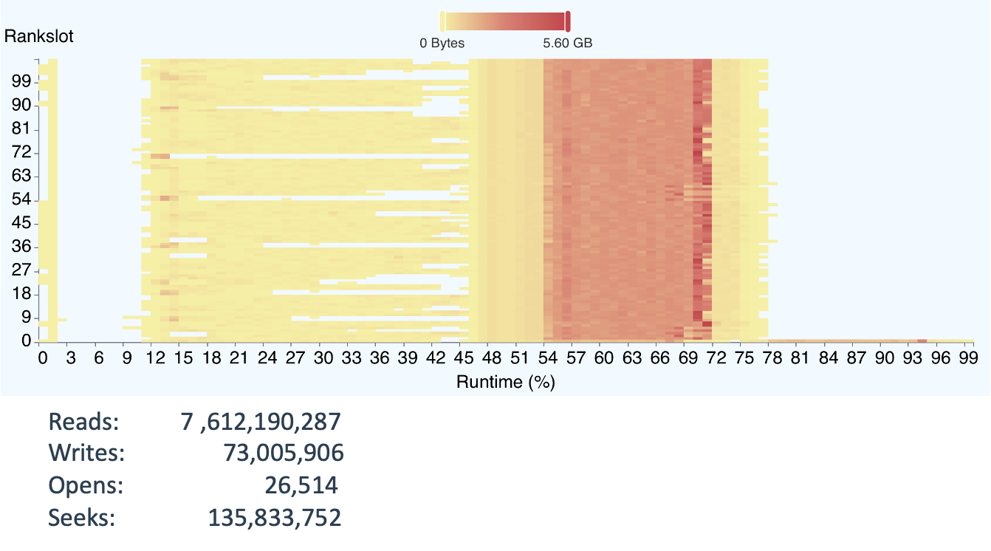
Use case: Quantum-Espresso
Electronic structure calculations (Phonon frequencies)

Slide 63
Conclusions
Presented the design, implementation, and evaluation of malleability techniques into the Hercules ad-hoc in-memory file system.
Malleability techniques allow to adapt (expand or shrink) the number of data nodes following a desired QoS metric.
Our approach eliminates the necessity of migrating large amounts of data between data nodes.
→ Ruled-based distribution policies, which modify the placement mechanism with a low impact. Rules are orchestrated in terms of predefined thresholds.
Ongoing work
→ To compute distance metrics with a larger number of experiments.
→ To elaborate heuristics to take better decisions and to predict the need of commissioning and decommissioning data server nodes.
→ To measure the impact of I/O malleability on metadata nodes.

